Slide 1

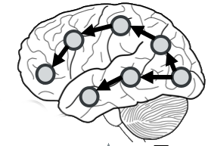
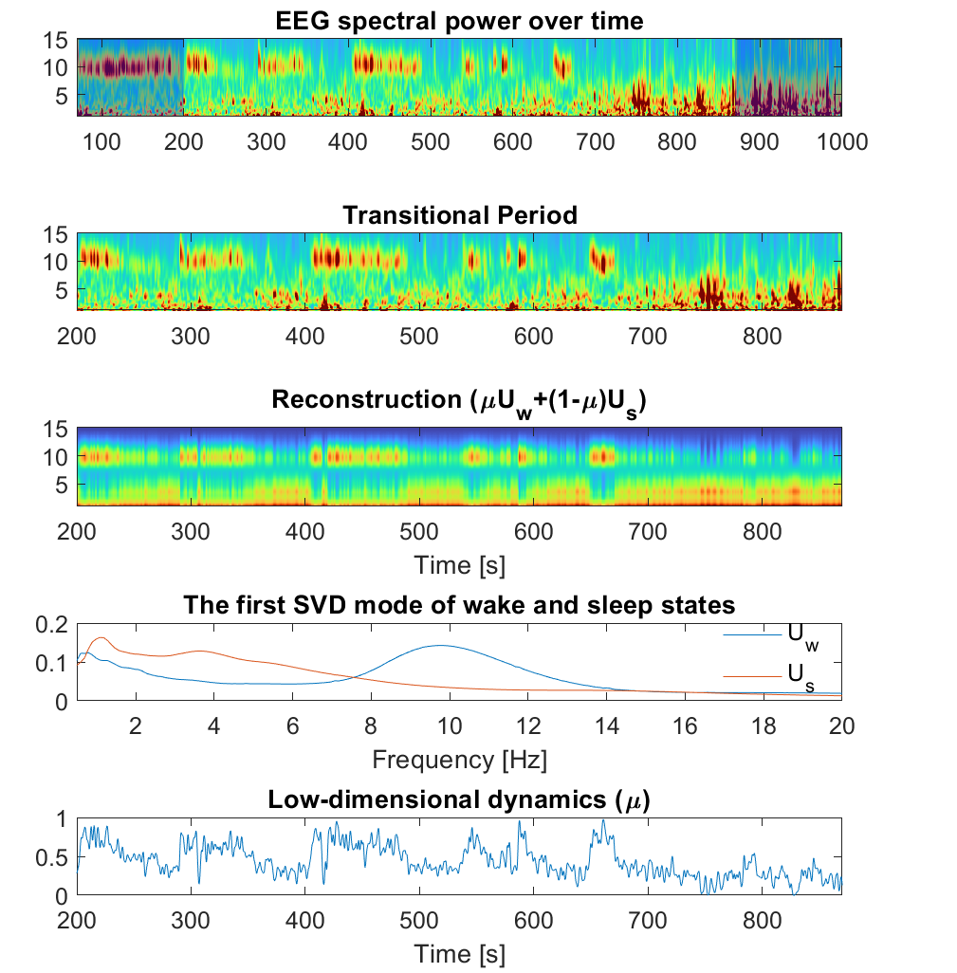
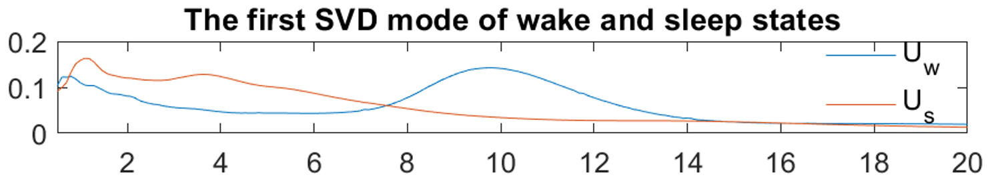
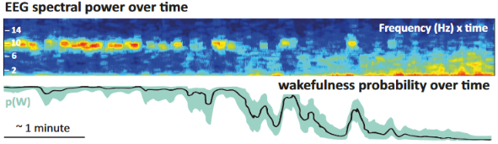
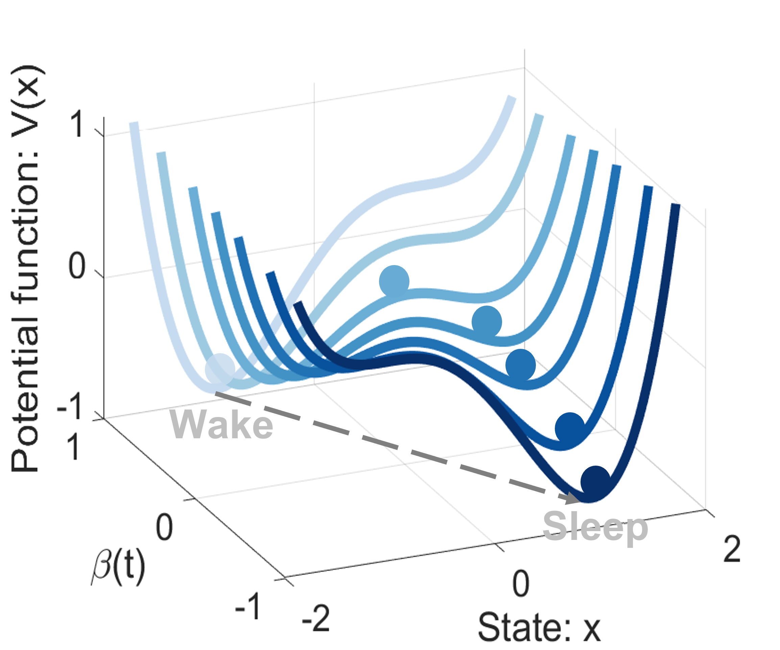
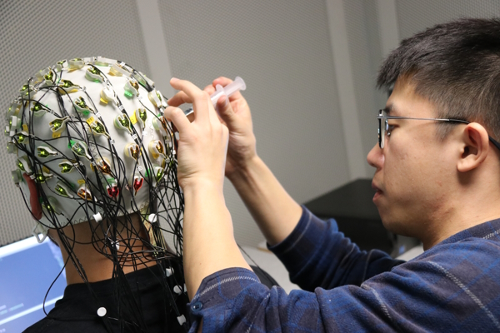
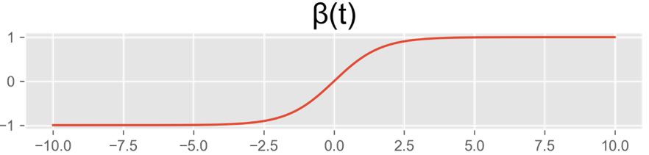

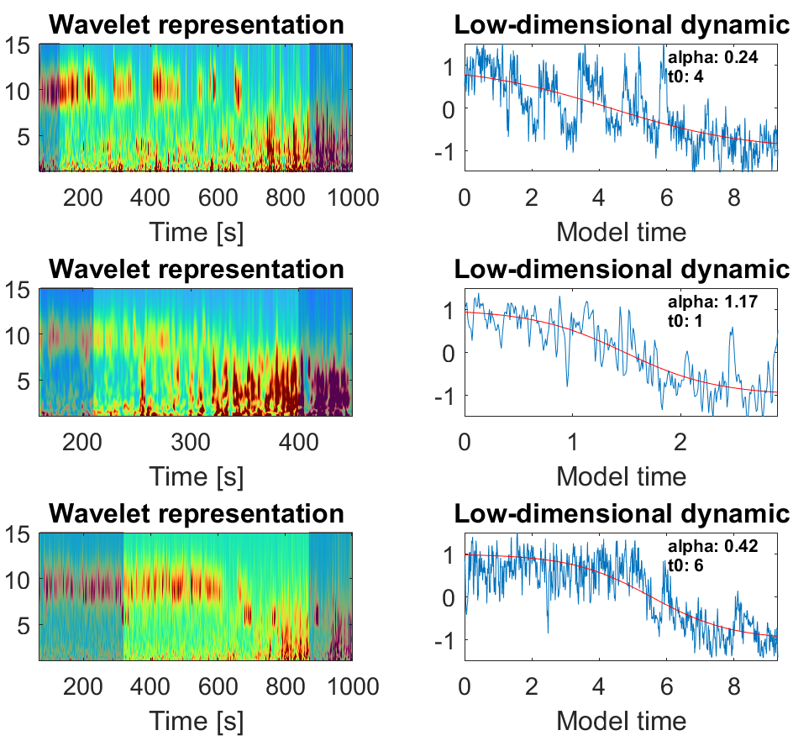
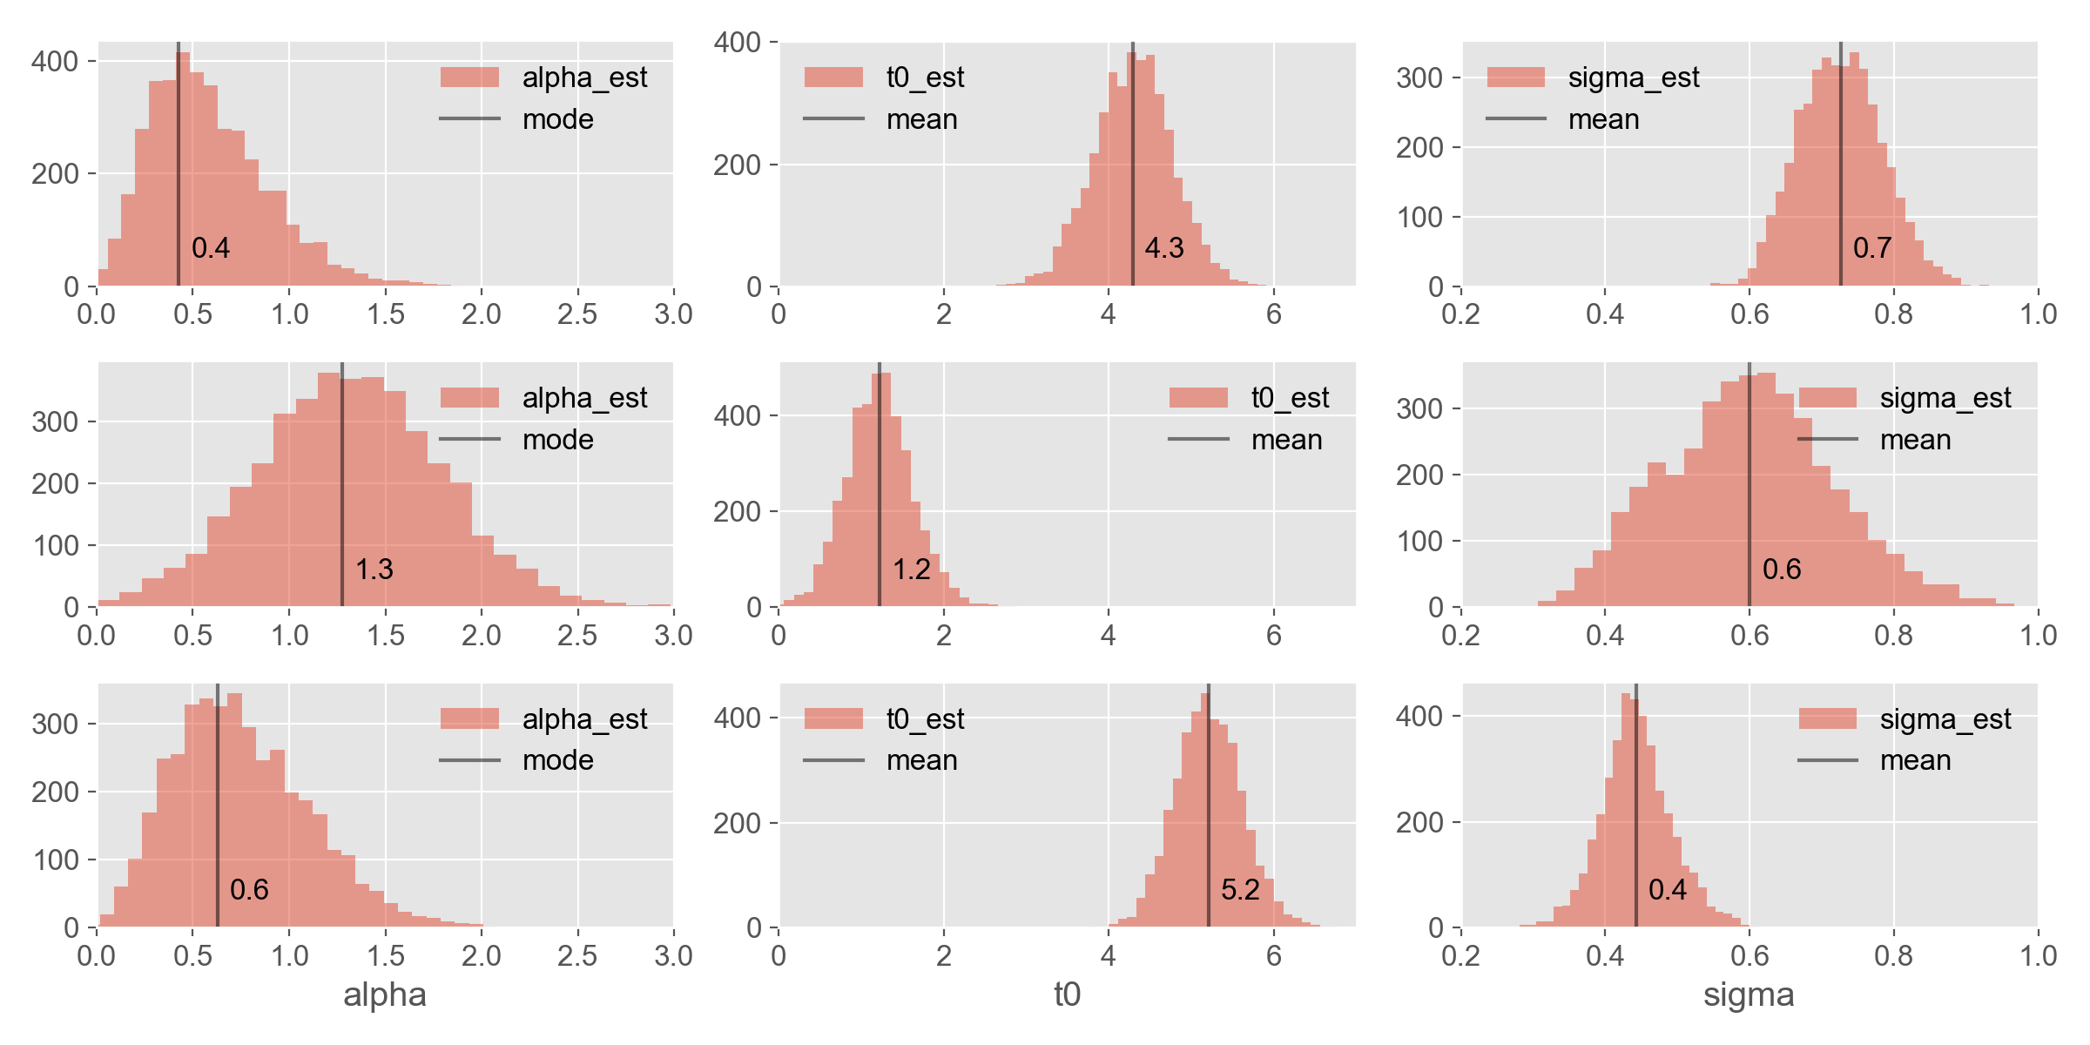

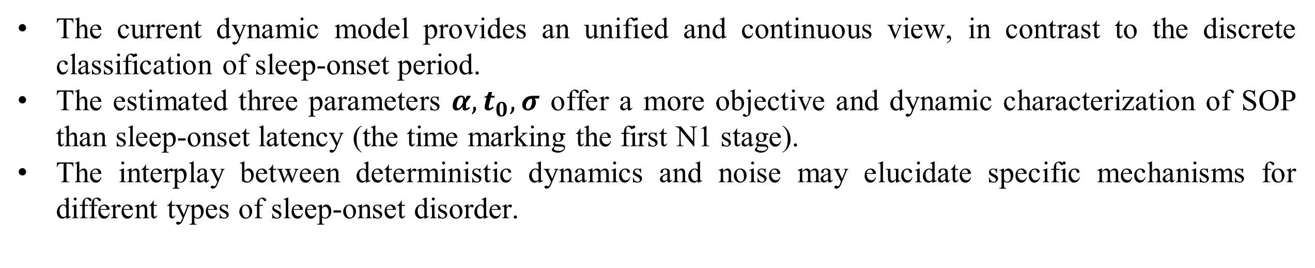
Modeling how people fall asleep
with a bistable dynamical system
Overview
Zhenxing Hu (PhD student @ DATAPHM - AS2M Dept. - FEMTO-ST)
I. Embedding
Context: The brain is an unknown, complex dynamical system which we are forced to study in a data-driven manner, using indirect measurements (e.g. electrodes on the scalp surface: EEG/electroencephalography). Control engineering
We compute a low-dimensional representation of the wake-to-sleep EEG spectrogram by (1) applying singular value decomposition (SVD) on the wake and sleep states separately and (2) approximating the transition as a linear interpolation between these two states
methods such as dynamical system identification are not mainstream in neuroscience, but they have a lot of potential to model brain behavior in both health and disease.
“Wake”
“Sleep”
Pessoa. The entangled brain: How perception, cognition,
and emotion are woven together.MIT Press, 2022.
time [s]
Biological question: This PhD project focuses on one specific phenomenon: changes in brain activity that occur when one transitions from wakefulness to sleep. In the sleep neuroscience community, the “sleep onset” period was long thought a simple “step” function (“one falls asleep”), but it is now recognized that it is dynamically complex. Almost nothing is known about these dynamics and how they differ within (e.g. coffee) and between (e.g. insomnia) individuals. .
time [s]
frequency [Hz]
Lacaux et al. Embracing sleep-onset complexity.
Trends in Neurosciences, 2024.
time [s]
II. Model structure
time [s]
and
Our approach: We model the wake-to-sleep dynamics using a stochastic dynamical model with cubic (i.e. bistable) dynamics. We fit the model’s parameters from the EEG data of sleeping participants (recorded in FEMTO-ST). We then evaluate the model’s parameters as biomarkers for sleep disorders.
We model the transition, 𝜇(t) as a stochastic cubic (i.e. bistable) dynamical model, which potential function is “forced” by a slowly-drifting hyperbolic tanh function 𝛽(t).
$$β=tanh⁡(α\left(t−t_{0}\right)dt$$
$$dx_{t}=−\left(x_{t}+1\right)\left(x_{t}−β\right)\left(x_{t}−1\right)dt+σ(1+\left|x_{t}\right|)dW_{t}$$
Model output
III. Preliminary Results
We fit model parameters to different individuals’ EEG recording using Bayesian Markov-Chain Monte-Carlo (MCMC).
Patil, Anand, et al., PyMC: Bayesian stochastic modelling in Python. Journal of statistical software, 2010.
Ind1
Ind2
Ind3
IV. Discussion
V. Acknowledgement
The current dynamic model provides an unified and continuous view, in contrast to the discrete classification of sleep-onset period.
The estimated three parameters $α, t_{0}, σ$ offer a more objective and dynamic characterization of SOP than sleep-onset latency (the time marking the first N1 stage).
The interplay between deterministic dynamics and noise may elucidate specific mechanisms for different types of sleep-onset disorder.
This work is supported by the Marie Skłodowska-Curie Actions (MSCA) Doctoral Networks LULLABYTE.
Supervisor: Dr. Jean-Julien Aucouturier (FEMTO-ST).
Collaborators: methodology: Prof. Nathan Kutz (University of Washington).
Dataset provider: Prof. Xu Lei (Southwest University).
Contacts
Zhenxing Hu
E-mail :
zhenxing.hu@femto-st.fr
Besançon, Belfort, Montbéliard, Sévenans
www.femto-st.fr

